Slide 1
RECIPIENT RIGHTS
Newaygo county mental health
Office of recipient rights

Slide 2
Purpose of Training
The goal of this course is to provide you with an understanding of the rights of individuals (recipients) who receive mental health services.
This training provides an understanding of your role in assuring rights are understood and protected, as well as what your responsibilities are in reporting.

Slide 3
Michigan Mental Health Code, Public Act 258 of 1974
“…recipients will be protected from rights violations while they are receiving services…”

Slide 4
WHO IS A RECIPIENT
Any PERSON who received services from a Mental Health agency
Clients
Consumers
Patients
Residents
Person with disability
Person with mental illness
As an employee, contract employee, or volunteer of Community Mental Health or of any of it’s contracted providers, you have a legal and ethical obligation to promote and protect the human and legal rights of recipients.

Slide 5
WHAT IS A RIGHT?
That which a person is entitled to have, to do, or to receive from others, within the limits prescribed by the law
Some things we think are rights aren’t actually rights
Rights are guaranteed but can be limited under certain circumstances
There is a different between a right and privilege

Slide 6
WHAT IS A RIGHT?
Some laws that affect mental health treatment and provide protection to individual’s right:
Michigan Mental Health Code
Michigan Administrative Rules
HIPAA
Americans with Disabilities Act
State and Federal Constitution

Slide 7
RELIGIOUS EXPRESSION
Recipients can freely choose their religious beliefs
Recipients should not be forced to attend any religious services, nor should they be prohibited
Staff should not force their beliefs upon recipients

Slide 8
Freedom of Expression/Association
To speak freely, write, or express views without restriction
To make and receive phone calls without restriction
To send and receive mail
To have visitors without restriction

Slide 9
Search and Seizure
Recipients have the right to own personal property
Dangerous items can be owned but may be restricted
Staff cannot take away personal items under most circumstances
Probable cause
Two person(s) must be present during search
Must allow for the recipient to be present
Must document on an incident report the outcome of the search

Slide 10
Americans with Disabilities Act (ADA)
Freedom of discrimination solely based on the basis of color, creed, nationality, sex, religion or disability
Protects from discrimination based on disability for employment
Requires business to make reasonable accommodations to their buildings so individuals with a disability can access them
Protects individuals with any type of disability from discrimination

Slide 11
HIPAA
Protects the privacy of individually identifiable healthcare information
Limits the use and disclosures of recipient information
Creates individual rights to inspect, copy, amend, request restrictions, file complaints, and receive notice of privacy practices

Slide 12
Confidential Information Includes:
Name and other personal details
Written information contained in the record
Verbal information related to the recipient
Acknowledging that a recipient receives mental health services
Any information obtained over the course of providing treatment to a recipient
CONFIDENTIALITY
330.7481-Disclosure of Confidential Information

Slide 13
CONFIDENTIALTY
PRIOR WRITTEN CONSENT MUST BE OBTAINED BEFORE RELEASING INFORMATION TO:
Doctors
Pharmacies
Lawyers
Other family members
Photographs, video/audio recording (including mobile phones)

Slide 14
EXCEPTIONS TO CONFIDENTIALITY
MEDICAL EMERGENCIES
Incidents that require visits to the emergency room would allow for the following information to be disclosed without consent being required:
Name
Address
Guardian information
Medications/Allergies
Other information that is required to treat the recipient

Slide 15
EXAMPTIONS TO CONFIDENTIALITY
DUTY TO WARN
If a recipient does the following:
Makes a threat of violence
Towards an identifiable third party
There is intent and ability to carry out the threat
It will occur in the reasonably foreseeable future
THIS HAS TRIGGERED YOUR DUTY TO WARN
DUTY TO WARN
MHC 330.1723
MHC 330.1946

Slide 16
Duty to Warn: Staff Responsibility
Contact clinical on-call staff for possible hospitalization
Contact police
Make an attempt to inform the third party
Notify guardian, and if minor, CPS

Slide 17
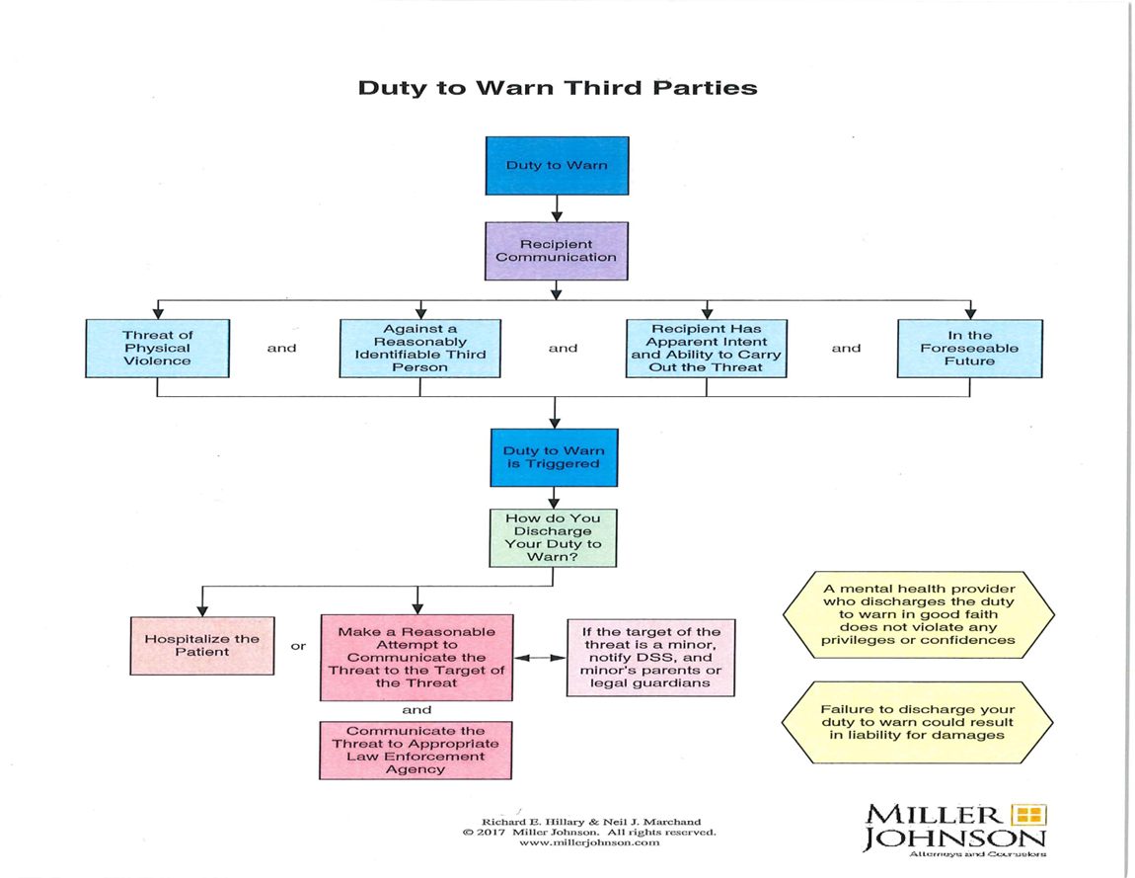

Slide 18
Staff May Not:
Send a recipient to “time out”
Physically manage a recipient to their room or other area
Restrict entry or exit by:
Locks
Staff presence
Timeframes
Seclusion May Only Be Used In Inpatient Hospital Settings
Freedom of Movement- Seclusion
330.7420

Slide 19
Restraints Are:
The use of clothing, ropes, or other material
Restricting wheelchair movement or mobility aids, e.g., crutches, walkers, etc.
Using safety restraints for purposes other than which they were ordered by a physician.
Restraints May Only Be Used In Inpatient Hospital Settings
RESTRAINT
MHC 330.7400
ADMINISTRATIVE RULE: 330.7243

Slide 20
Treatment Is Voluntary
Medications should not be used as a form of restraint.
Do not hide medications in food or give to the recipient without their knowledge.
Recipients have the right to refuse medication and other treatment
A doctor cannot write an order that supersedes law
RESTRAINT MHC 330.7400
ADMINISTRATIVE RULE 330.7243

Slide 21
Appropriate Treatment
Recipients have the right to adequate and appropriate treatment when receiving services
A Person Centered Plan is a prescription for care
Staff MUST be familiar with each recipient’s Person Centered Plan
FAILING to KNOW and FOLLOW a plan is a rights violation
MENTAL HEALTH SERVICES SUITED TO CONDITION 330.7080

Slide 22
PERSON CENTERED PLAN
A process for planning and supporting a person receiving services that builds on a person’s desire to engage in activities that promote community life and honor’s his or her individual preferences, choices, and abilities
Highly individualized
Presumes the individual is competent to direct the planning process
Presumes the individual has the capacity to achieve goals and outcomes, and build a meaningful life in the community

Slide 23
DIGNITY & RESPECT
DIGNITY
RESPECT
to be treated with esteem, honor, politeness; to be addressed in a manner that is not patronizing, condescending or demeaning; to be treated as an equal; to be treated the way any individual would like to be treated.
to show deferential regard for; to be treated with esteem, concern, consideration or appreciation; to protect the individual’s privacy; to be sensitive to cultural differences; to allow an individual to make choices.
FAMILY DIGNITY AND RESPECT MHC 330.7111
Treatment with dignity and respect shall be further clarified by the recipient or family member, and considered in light of the specific incident, treatment goals, safety concerns, laws and standards, and what a reasonable person would expect under similar circumstances.

Slide 24
EXAMPLES
Talking in a calm and kind tone of voice
Getting angry without showing it
Not calling recipients by pet names
Being patient with recipients
Not discussing personal issues with recipients
Protecting the privacy of recipients
Treating recipients as your equals
Allowing recipients to make choices
Treating recipients with esteem, honor and politeness
Treating recipients in an age appropriate manner

Slide 25
ABSOLUTE vs. LIMITED RIGHTS
ABSOLUTE-CANNOT BE LIMITED
LIMITED-CAN BE LIMITED
Freedom from abuse and neglect
Treatment suited to condition
Dignity and respect
Safe, sanitary, and humane treatment environment
An individual plan of service via the PCP
Contact with attorneys or others regarding legal matters
Access to records
Access to Recipient Rights
Communication by mail, phone, and/or visits
Access to personal property
Access to money
Freedom of movement
Confidentiality/privilege
Consent to treatment
MUST IDENTIFY MEASURES TO REDUCE OR ELIMINATE BEHAVIOR

Slide 26
Abuse Class I
A non- accidental act or provocation of another to act that caused or contributed to:
Death
Sexual Abuse
Serious Physical Harm

Slide 27
Abuse Class I- Sexual Abuse
Criminal sexual conduct involving an employee, volunteer, or agent of a provider and a recipient
Any sexual contact involving an employee, volunteer, or agent of a provider, or agent of a hospital or a facility
Any sexual contact between an employee, volunteer, or agent of a provider and a recipient whom the employee, volunteer, or agent provides a service

Slide 28
Abuse Class I- Sexual Contact
Intentional touching or penetration of a recipients or staff intimate parts, or the intentional touching of the clothing which covers those intimate parts if the action can be reasonable seen as being for the purpose of arousal, gratification, or for a sexual purpose or nature, or for revenge, or to inflict humiliation out of anger.

Slide 29
Abuse Class II
A non-accidental act of provocation of another to act that caused or contributed to Non- serious physical harm
Exploitation
Emotional Harm
Unreasonable Force

Slide 30
Abuse Class II - Definitions
EXPLOITATION
The misappropriation or misuse of an a recipient’s property or funds for the benefit of an individual(s) other than the recipient.
EMOTIONAL HARM
Impaired psychological functioning, growth, or development of a significant nature as evidenced by observable physical symptoms

Slide 31
Abuse Class II-Unreasonable Force
Physical Management (PM)
Techniques used to restrict the movement of a recipient
Force
Non-accidental physical strength exerted against the body of a recipient
WITH OR WITHOUT APPARENT HARM
When no immediate risk of physical harm to self or others
Not in compliance with approved behavior management techniques
Not in compliance with the recipient’s IPOS/ Treatment Plan
When other less restrictive measures were not attempted immediately before use of PM of Force

Slide 32
Abuse Class III- Verbal
USE OF LANGUAGE OR OTHER COMMUNICATION:
This includes body language and/or gestures
…THAT IS/ARE DEGRADING, THREATENING OR SEXUALLY HARASSING
Sexual advances to a recipient, requests for sexual favors from a recipient, or other conduct or communication of a sexual nature toward a recipient, either wanted or unwanted.

Slide 33
Neglect Class I
AN ACT OF COMMISSION OR OMISSION THAT RESULTS FROM A NON-COMPLIANCE WITH A STANDARD OF CARE OR TREATMENT REQUIRED BY:
Law
Rules
Written Directives
IPOS
Policy/Procedure
Guidelines
THAT EITHER CAUSED OR CONTRIBUTED TO:
Death Sexual Abuse Serious Physical Harm

Slide 34
Neglect Class II
AN ACT OF COMMISSION OR OMISSION THAT RESULTS FROM A NON-COMPLIANCE WITH A STANDARD OF CARE OR TREATMENT REQUIRED BY:
Law
Rules
Written Directives
IPOS
Policies/Procedures
Guidelines
THAT EITHER CAUSED OR CONTRIBUTED TO:
Non-Serious Physical Harm Emotional Harm

Slide 35
Neglect Class III
AN ACT OF COMMISION OR OMISSION THAT RESULTS FROM A NON-COMPLIANCE WITH A STANDARD OF CARE OR TREATMENT REQUIRED BY:
Written Directives
IPOS/Treatment Plans
Law
Rules
Policies/Procedures
Guidelines
THAT EITHER PLACED OR COULD HAVE PLACED A RECIPIENT AT RISK OF:
Physical Harm Sexual Abuse

Slide 36
Examples of Neglect
Not providing pain medication as prescribed
Leaving a “one on one” recipient alone
Sleeping on duty
Not securing items that pose risk to recipient/others
Leaving recipients alone in a van
Not providing medical treatment when needed
Mis-dosing medication (too much or too little)
Not following a Treatment Plan as written
Being aware of an abusive or neglectful situation and not reporting it

Slide 37
FAILURE TO REPORT
THE FAILURE TO REPORT ANY INCIDENT THAT IS ABUSE OR NEGLECT IS NEGLECT
IMMEDIATE ORAL REPORT
WRITTEN REPORT WITHIN 24 HOURS

Slide 38
WHAT IS YOUR DUTY TO REPORT
You must immediately report directly to the Office of Recipient Rights and your supervisor:
Serious injury or death
All apparent or suspected violation of rights
The terms “apparent” or “suspected” mean ANY OCCURENCE THAT
You witnessed Received a report of (written or verbal) Have information about
WHETHER OR NOT YOU BELIEVE THAT ALLEGATION TO BE TRUE

Slide 39
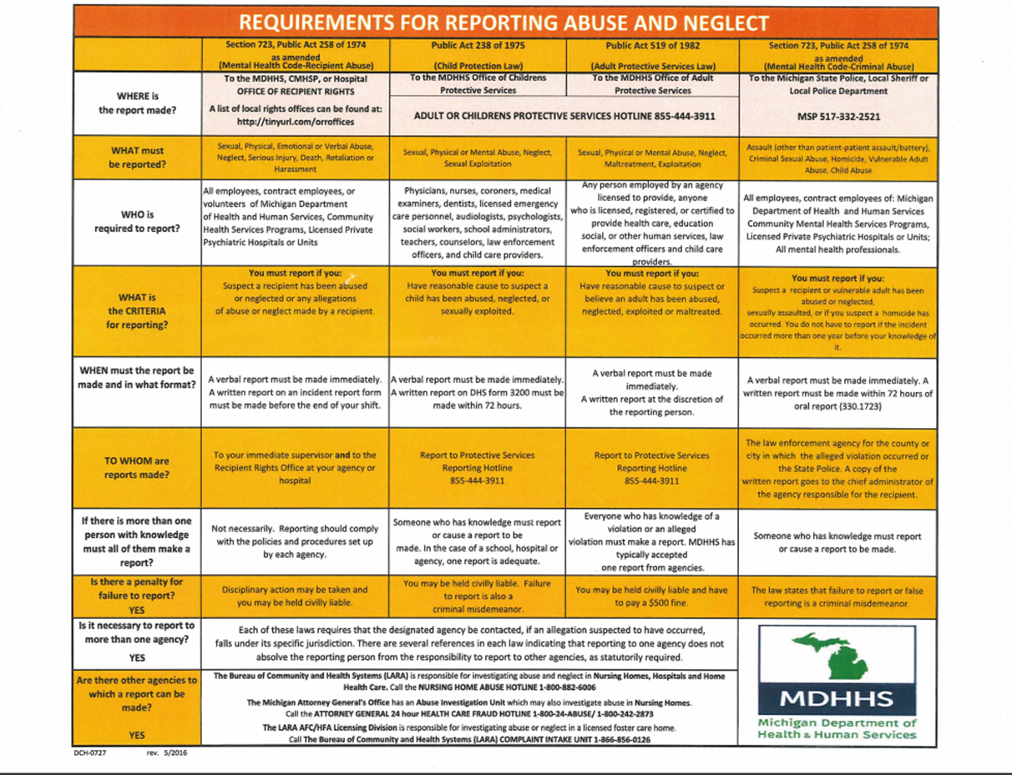

Slide 40
RIGHTS PROTECTION SYSTEM
FILING A COMPLAINT IS A RIGHT
RECIPIENT
GUARDIAN
PARENT OF A MINOR
STAFF
ORR
ANY PERSON ACTING OF BEHALF OF A RECIPIENT
You are obligated to assist a recipient with both accessing ORR and filing a complaint; even if the complaint is about you or the services you have provided.

Slide 41
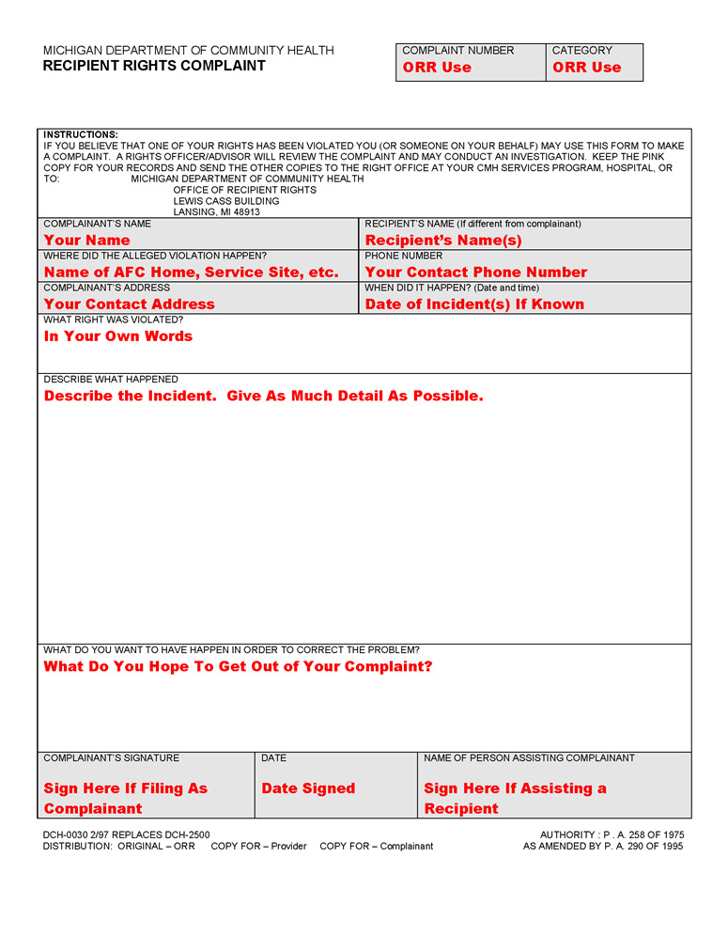
FILING A COMPLAINT
You are required to notify your immediate supervisor AND the ORR of any suspected rights violations
You must assist a recipient in filing a complaint form if requested; even if the complaint is about you
You may also file a complaint on behalf of the recipient
Complaint process is a confidential process
Provides certain rights to complainant
A Summary report upon completion
Appeal Rights

Slide 42
APPEAL PROCESS
Basis for Recipient Rights Appeal
Investigative findings not consistent with facts, laws, rules, policies or guidelines
Investigation by ORR not timely
The action taken (or plan of action proposed) does not provide an adequate remedy
Who can file an appeal
Complainant
Client (if different than the complainant)
Parent or Guardian (as applicable)
Where to file an appeal
Recipient Rights Appeals Committee
Newaygo County CMH
Staff Responsibility
Assist complainant with filing appeal
(Client, if different than complainant, parent or guardian may also file an appeal)

Slide 43
INCIDENT REPORT
Any happening, event or situation not consistent with desired operation of NCMH and which caused or may have the potential to cause injury to clients, visitors, students or staff; or loss or damage to property

Slide 44
COMPLAINT vs. INCIDENT REPORT
Complaint form
Incident report form
When asked to fill out by recipient
Witnessing someone violate a right
Overhearing of someone violating a right
Can be for a rights violation, service dispute or any complaint brought forth
Physical aggression not in BTP
Any contact with 911
Injury to recipient/staff during physical aggression
Self-inflicted harm (attempt or completed)
Suicidal attempt or gesture
Physical management

Slide 45
INCIDENT REPORTING
PROPERTY DAMAGE
SEARCH AND SEIZURE
ELOPMENTS
INJURY, INTENTIONAL OR ACCIDENTAL, RESULTING IN EMERENCY MEDICAL CARE
DEATH OF RECIPIENT
ADVERSE MEDICATION REACTIONS
MEDICATION ERRORS (NOT REFUSALS)
PHYSICAL ILLNESS RESULTING IN EMERGENCY MEDICAL CARE
HOSPITALIZATION DUE TO ACUTE OR CHRONIC ILLNESS
CONTRACTION OR SUSPECTED CONTRACTION OF A COMMUNICABLE DISEASE
TRAFFIC ACCIDENTS
FIRES
ARRESTS

Slide 46
TIPS FOR REPORT WRITING
Use full names, date and times
Avoid labels
Use your senses: what did it look like, sound like, etc.
Be specific
Don’t use assumptions, stick to the facts
Document everything
Do not fill in gaps with opinions

Slide 47
INVESTIGATIVE PROCESS
INVESTIGATION
Response required within 5 business days with:
File number
Date complaint was received
Summary of the complaint
Action taken
Status letters required at 30 and 60 days
90 days for completion
Summary report to go to recipient/guardian, complainant
INTERVENTION
Response required within 5 business days
Facts are clear
No remedial action required
30 days for completion
Report to recipient

Slide 48
Other options…
No Code Protected Rights
There is no protection within any of the laws which give protection for specific complaint alleged
Out of Jurisdiction
The complaint brought forth is outside of the jurisdiction of the Office of Recipient Rights
i.e. which medications are prescribed to a recipient by physician

Slide 49
INVESTIGATIVE PROCESS
REVIEW DOCUMENTATION
INTERVIEW STAFF OF THE HOME/AGENCY
INTERVIEW RECIPIENTS OF HOME
REVIEW POLICY/PROCEDURES

Slide 50
ORR ACCESS
ALL RESIDENTS OF A HOME (CMH OR NOT)
ALL STAFF OF A HOME/AGENCY
ALL STAFF CONTACT INFORMATION
ALL TRAINING RECORDS
ANY OF REQUEST DOCUMENTATION

Slide 51
The Whistleblowers Protection Act
You cannot be retaliated against if you file a complaint in good faith
You cannot retaliate against a recipient or another staff that has filed a complaint
You have to believe the allegation occurred
Mental Health Code protection: Retaliation and Harassment
Illegal for employers in Michigan to discharge, threaten, or otherwise discriminate against you because you report a violation or suspected violation of federal, state or local laws, rules or regulations to a public body; or because you take part in a public hearing, investigation, inquiry or court action.

Slide 53
Office of Recipient Rights
Jill McKay,
Officer of Recipient Rights
Andrea Fletcher,
Recipient Rights Advisor
Kathleen Smith,
Recipient Rights Advisor
1049 E. Newell St.
P.O. Box 867
White Cloud, MI 49349
(231) 689-7080 Direct Line 231-787-1305 Fax
jmckay@newaygocmh.org
afletcher@newagyocmh.org
ksmith@newaygocmh.org

